Slide 1
Cheap Oil Jamming Rails Means Higher U.S. Power Bills

Slide 2
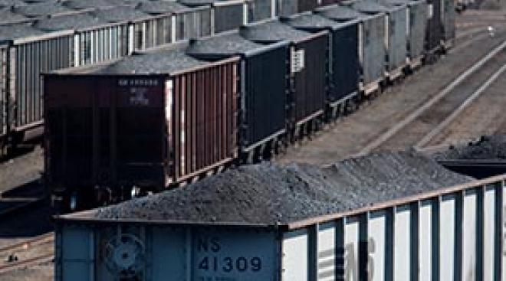
Company Description
Poor system of coal transportation
Usage of natural gas a contributing factor
Negative effect on next generation
Notes:
Despite the fact that U.S has the largest coal reserves in the world, its cost of electricity is high due to its poor system of coal transportation.
An increase in the cost of electricity is as a result of use of the natural gas as coal’s alternative.
The insufficient supply of coal to the mines will affect the coming generations as the cost of electricity will be more costly than before.

Slide 3
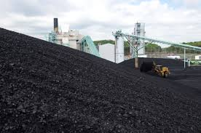
Industry Position
Struggling industry
Sharp decline w/ prediction of shortage in 2020
Renewable energy - may better industry
Xcel Energy example

Slide 4
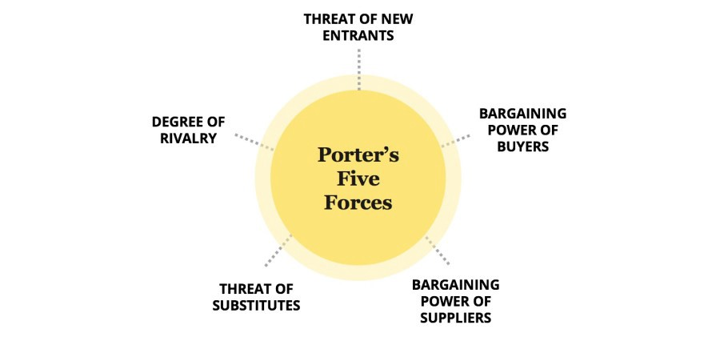
Competitive Forces
Threat of substitute goods and services
Threat from other industries
Ethical questions about coal

Slide 5

Strategic Recommendations
Stop throwing money at a dying industry pretending it will revive it
Start investing that money in renewable energy which will:
  Provide a higher return on investment
  Drive energy costs DOWN instead of up
  Remain a plausible energy source when fossil fuels are gone

Slide 6
California Continues to Move Toward Electric Mobility

Slide 7

Company Description
CPUC
Another $1 billion to the existing $43 million budget
Cut petroleum and greenhouse gases
Renewable energy increase (2030)
Unregulated fossil fuels
Heavily regulated electricity

Slide 8

Industry Position
Growing industry
Green initiatives
Increasing demands
EV = lower petroleum levels

Slide 9

Competitive Forces
Current forces
  Sellers; substitute goods and services
Future forces
  Buyers; new entrants

Slide 10

Strategic Recommendations
Reallocate tax breaks from fossil fuels to green energy
This change will create positive externalities instead of negative ones
  Lower energy costs instead of higher
  Reduced pollution instead of increased pollution

